Slide 1
Explorations of BSSN Formalism in Spherical Symmetry
AMATH 741 Final Presentation
Hank Chen, Leo Kim, Dorsa Sadat Hosseini Khajouei
Project based on arXiv:0705.3845/Class.Quant.Grav.25:205004 (2008)
April 14, 2021

Slide 2
Overview
Theoretical Foundation
Numerical Implementation
Results

Slide 3
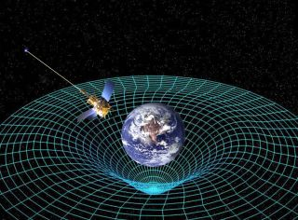
General Theory of Relativity
Generalization of special relativity - refines Newtonian gravitation
Key idea: Gravity as spacetime geometry
Very well tested: one of the most successful physical theories
Image credit: NASA, Gravity probe B
Notes:
Generalization of SR - in what sense? (to non-inertial/accelerating frames)
say: ”Space tells mass how to move, mass tells space how to curve”
Speak more about physical quantities: how particles move along geodesics, and how curvature describes gravitational tidal forces
Mention predictions: mercury perihelion, light-bending around sun, etc.
Reference picture

Slide 4
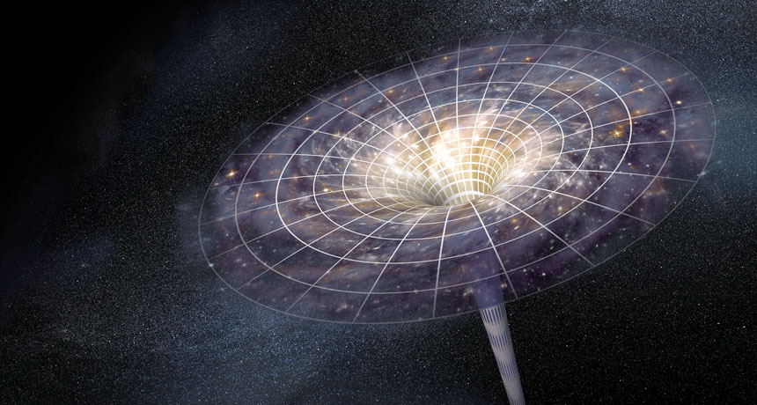
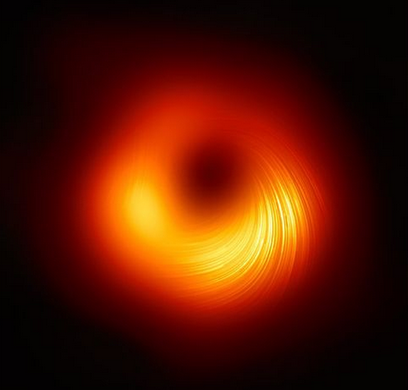
Einstein Field Equations (EFEs)
Equations of motion for geometry in terms of metric tensor
Schwarzschild blackhole: unique static spherically symmetric solution
Black hole singularity
Image credit: M87 observation, EHT
Notes:
State briefly what the metric is (measures distances), and explain what the Ricci tensor/scalar describe physically (curvature)
Explain briefly the properties of Schwarzchild metric: spherical symmetry (the solid angle measure d\Omega), coordinate singularity at r = 2M, and what it means physically
Here static means that \partial_t is Killing, i.e. the Schwarzchild metric does not evolve. Say “we want to go beyond static solutions in order to study the evolution of celestial dynamics”
M87 blackhole - accretion around horizon, EHT= Event Horizon Telescope

Slide 5
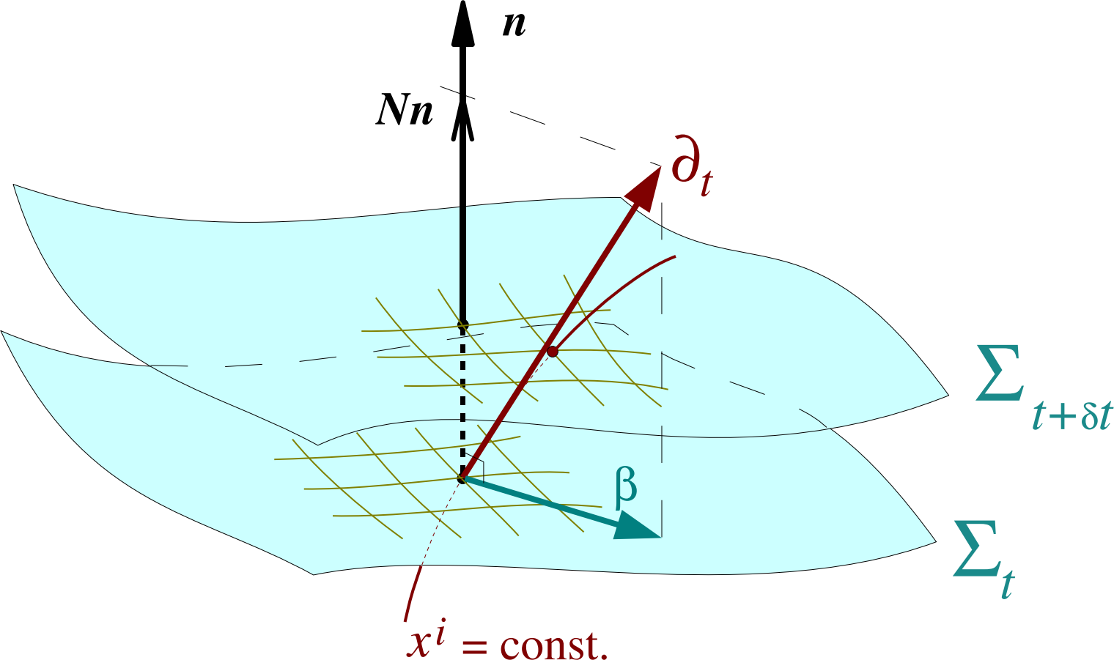
Numerical Relativity
ADM Hamiltonian Formalism: (3+1)-split
3D spatial surface Σ + time
Lapse α and Shift β: control spatial slicing
Gives: time-evolution for spatial metric g
BSSN Formalism (Shibata & Nakamura 1995; Baumgarte & Shapiro 1999; Brown 2008)
Improve numerical stability (with gauge-fixing auxiliary variable)
Our focus: Generalized BSSN (GBSSN)
Image credit: E. Gourgoulhon, arXiv:gr-qc/0703035 (2007)
Notes:
Motivat briefly the Hamiltonian formailsm: EFEs (as is on the prev slide) requires solving for all 4 components of metric simultaneously; we want a time-evolution system of the spatial metric
Speak more about why we want to relax the unit-determinant condition (spherical symmetric metric in flat space has non-unit determinant)
Include constraints brief explanation, can compare with electric & magnetic fields for analogy

Slide 6

GBSSN Formalism
Nine state variables:
Lapse α and Shift β: evolution of foliation
Auxiliary variable B: gauge-fixing under time-evolution
Conformal factor χ: determinant of (physical) spatial metric g
Conformal metric γ: radial and angular parts
Conformal connection Γ: parallel transport
Extrinsic Curvature K, A: curvature of 3-space; trace-free part A
The evolution equations are a huge mess!
Notes:
Briefly explain how \gamma is defined in terms of g (just divide by \chi).
Need to explain what each state variable means, especially parallel transport and the curvature, and how we can extract useful physical quantities from them.
NOTE: Might want to take this slide out and just put the state variables in the prev slide. However, this will require you to explain very briefly what the state variables are/mean (this is pretty difficult to do in my experience)

Slide 7
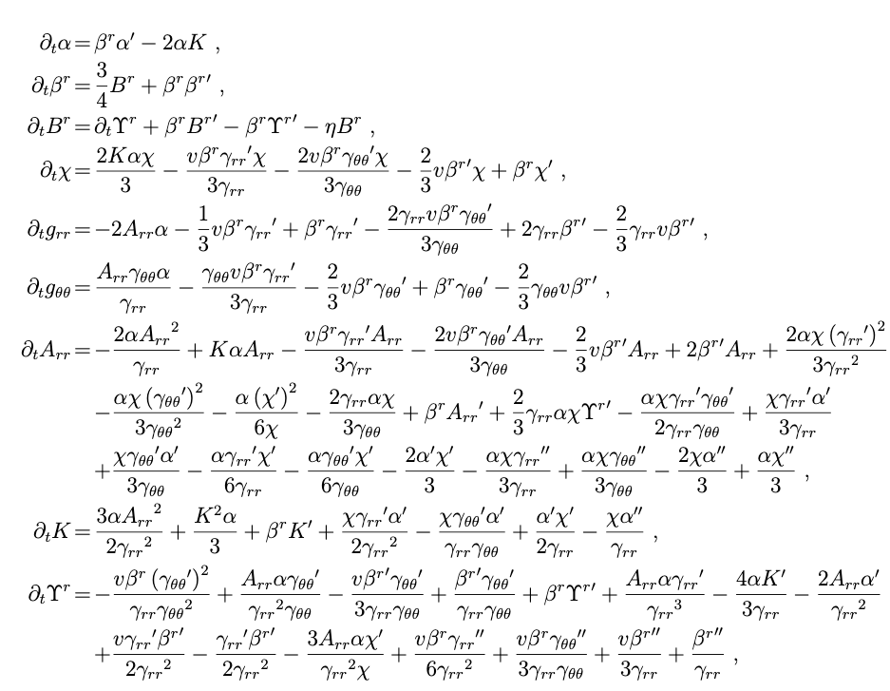
Numerical methods
Set-up
At each point in space, have a 9 dimensional vector.
Use finite differences!
Time!
Fourth-order Runge-Kutta for time integration using MATLAB’s built-in ode45 integrator.
GBSSN equations give time update rule - need first and second order spatial derivatives!
Space!
Fourth-order finite difference with central stencil for spatial dimension.
Requires total of 5 points!
Boundary conditions: parity at origin, (artificial) analytical extension at maximum distance.

Slide 8
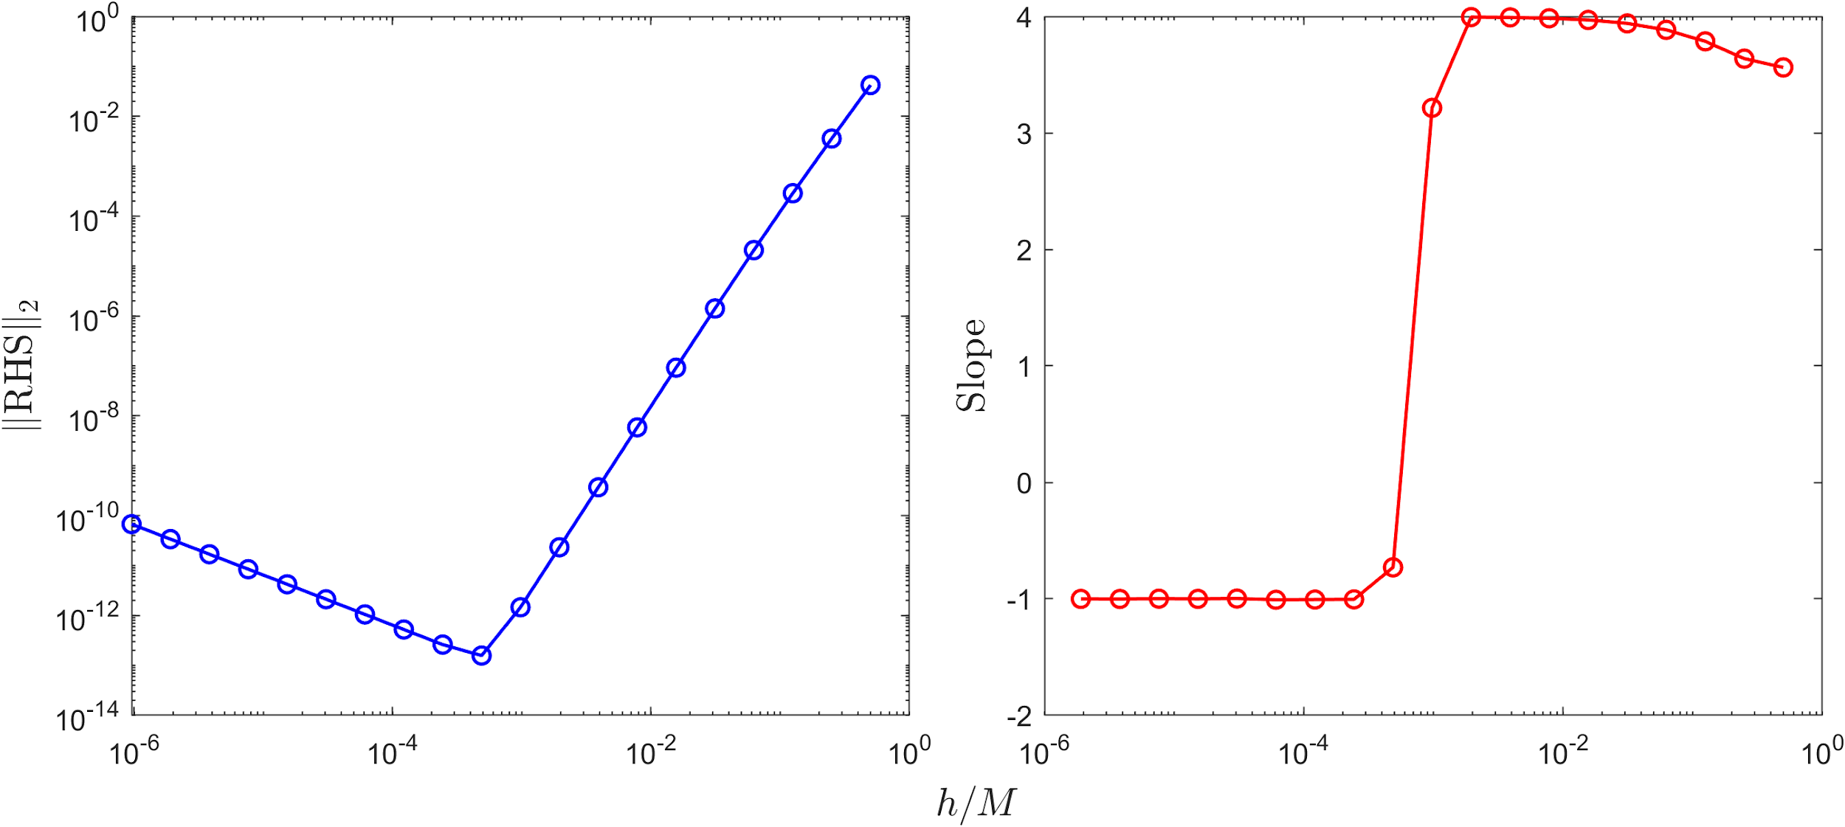
Simple test: flat spacetime
Note: This has minimum and maximum radius
Notes:
Include some key points here

Slide 9

Puncture time evolution
Image credit: M87 observation, EHT
Notes:
Correct metric
Speaker notes rescaled differences for fourth ordre convergen

Slide 10
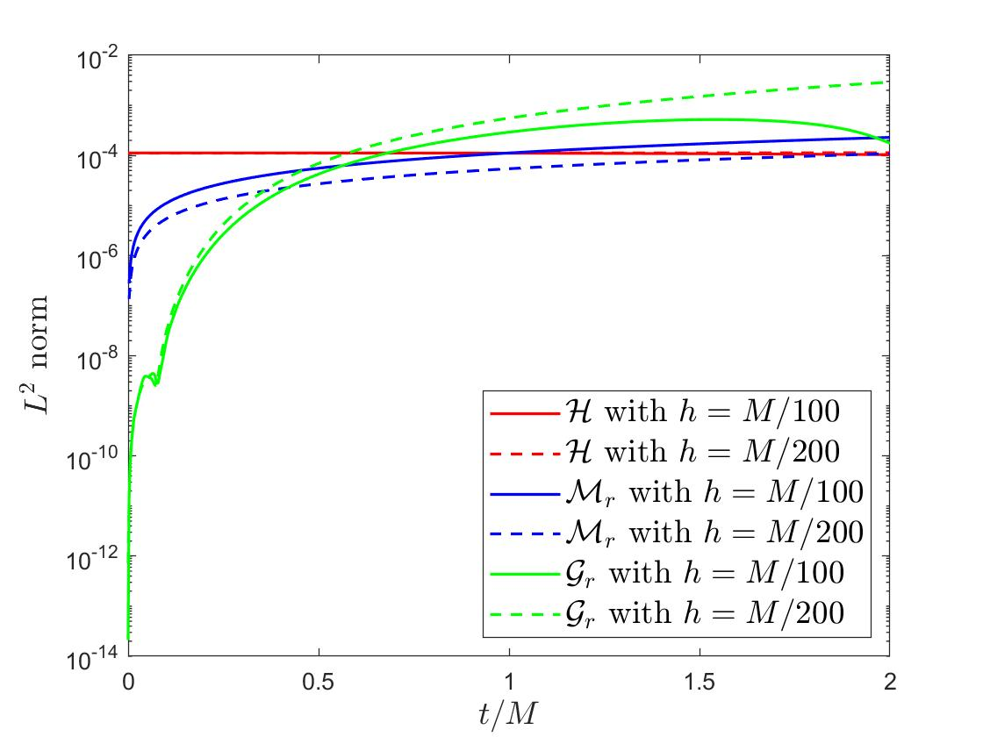
Results: Constraints
Hamiltonian H
Momentum M,
Conformal G
All must vanish (up to finite-differencing error)
Notes:
Key: must all vanish
These are rescaled

Slide 11
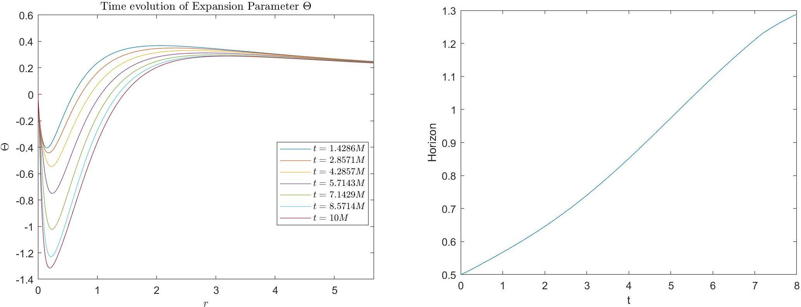
Results: Expansion and Horizon
Onset of blackhole formation
Image credit: M87 observation, EHT
Notes:
Explaining expansion and trapping of null geodesics
These + lightcones are new things, mention

Slide 12
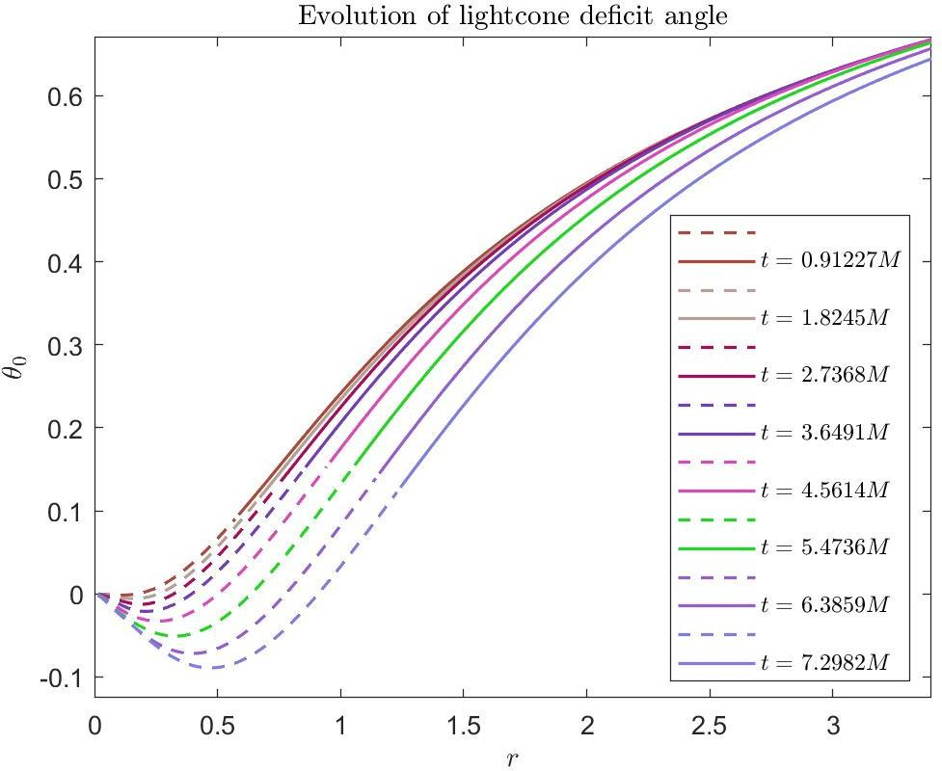
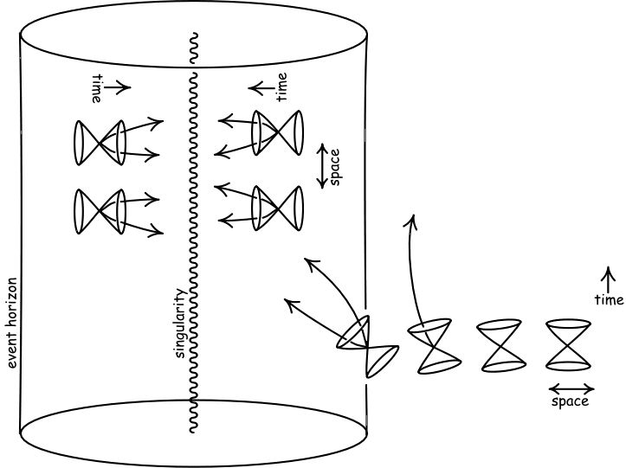
Results: Lightcones
Behaviour of geodesics near event horizon
Image credit: Einstein for Everyone, John D. Norton, 2007
Notes:
Explain lightcone tilting \theta_0; geometry
Singularity at horizon

Slide 13
Conclusion
Based upon GBSSN numerical scheme of Brown 2008
Fourth-order finite differencing & convergence
Explorations (our work): computed physical quantities
Expansion & Horizon
Lightcone
Special thanks to Dr. Erik Schnetter for his guidance throughout the project

Slide 14
Reference
1) https://www.space.com/black-holes-event-horizon-explained.html
2)https://arxiv.org/pdf/gr-qc/0703035.pdf
3) arXiv:0705.3845/Class.Quant.Grav.25:205004 (2008)

